Slide 1
Let's reinvent CLIs one last time... kinda
Jan Oehen | Ryan Bartram
Notes:
Dear speaker,
your session will be recorded and published (unless otherwise agreed).
Please ensure that:
Your screen resolution is set to 1920x1080 pixels.
Your device should have a (full size) HDMI output. You're welcome to bring a proper dongle for your device, if this connection is missing.
Your device must not provide protected output such as HDCP (especially important for MAC users).
Start the countdown (slides 2-4) IMMEDIATELY BEFORE you talk to the audience!
The countdown is important in terms of video editing after the conference. The published session will start with slide 5. Feel free to remove slide 1-4 before you upload the slides to the conference repository.
Good luck! 💙

Slide 2

Many thanks to our sponsors:

Slide 3


Ryan Bartram
Both Azure Cloud Engineers
Both Automation/pwsh Advocates
Both work at Worxspace
In other words
Same same, but different…
But still same
…and sometimes we do podcasts
Jan Oehen

Slide 4
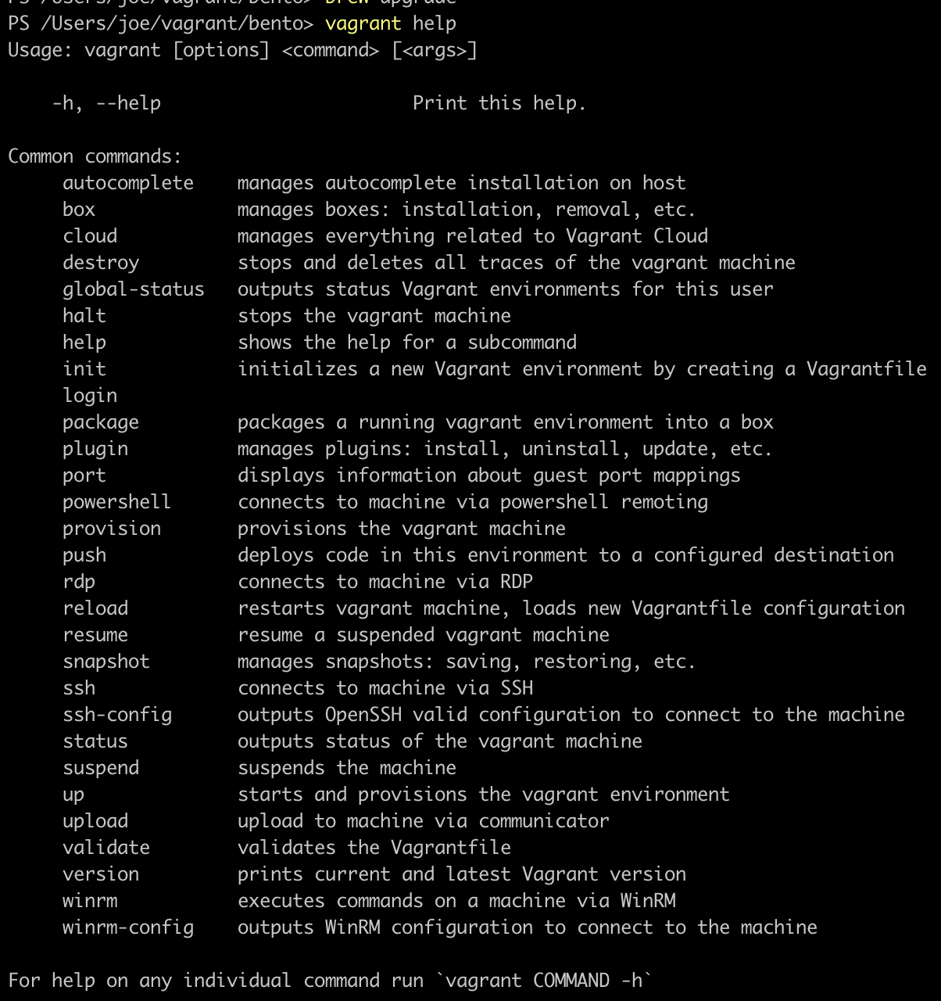
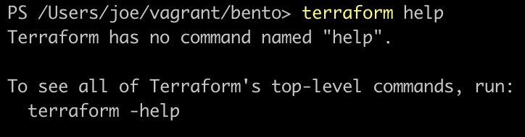
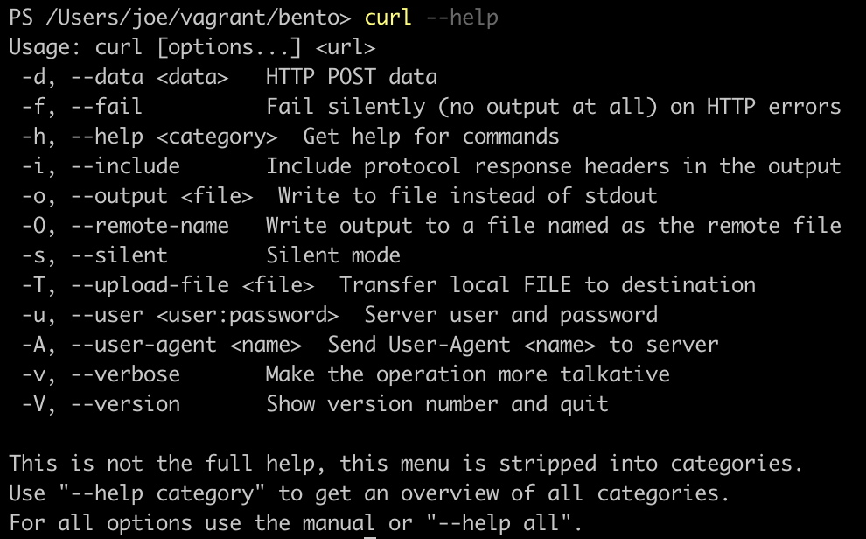
Reinventing the wheel
Notes:
“<cmd-name> help” don’t always return actual help
Verbs are not standardized. i.e. Vagrant halt instead of vagrant stop (worst offender homebrew)
The verb-noun syntax is a work of art
Inconclusive help, no examples
Once you find correct syntax, result still specialized rather than objects

Slide 5
Demos
We love Demos!

Slide 6

Notes:
Microsofts guidelines don’t advise to build all CLIs in Crescendo, probably because of this

Slide 7
Q&A
15 minutes

